Slide 1

“Your Project Name”
CHAT APPLICATION AND WEBSITE
Task - 1

Slide 2
Chat application and website
The development of this project centered on the development of a message protocol that would allow the application to properly log in users, send messages, and perform system maintenance.
LMS USERNAME | NAME | BATCH
2115a624 | Vijayaraghul.G | A6
2115a625 | Vimalraj.D | A6
2115a627 | Vishwa.R | A6
2115a614 | Teja.B | A6

Slide 3
Task - 1
Creation of SRS & Github
Create SRS : “Your Project”
Creation & Set-up of Github account
Creation & Hands-on to various commands of Git Bash
Evaluation Metric:
100% Completion of the above tasks
Learning Outcome
Get to know about different lifecycle models.
Understanding importance and how to create an SRS
Knowing various commands of Github
Understanding agile and scrum management techniques for efficient product development

Slide 4
SRS for “Chat application and website"
Functional Requirements
Conversation: The system should support one-on-one and group conversations between users
Acknowledgment: The system should support message delivery acknowledgment, such as sent, delivered, and read.
Sharing: The system should support sharing of media files, such as images, videos, and audio

Slide 5
SRS for “Chat application and website"
Non Functional Requirements
Low latency: Users should be able to receive messages with low latency.
Consistency: Messages should be delivered in the order they were sent. …
Availability: The system should be highly available. …
Security: The system must be secure via end-to-end encryption.

Slide 6
SRS for “Chat application and website"
Software Requirements
Software Operating system (such as window 7, 8, xp, Linux etc). Code done in python so required Python 3 for run python program.

Slide 7
SRS for “Chat application and website"
Hardware Requirements
Minimum requirements will be as follows:
128 MB RAM required.
Processor with speed of 500 MHz.
Internet or LAN connection.
MOUSE: 2 or 3 button mouse
KEYBOARD: 101 key Keyboard

Slide 8
Step-Wise Description
The system to be developed here is an Chat facility. It is a centralized system. It is Client-Server system with centralized database server. All local clients are connected to the centralized server via LAN.
There is a two way communication between different clients and server. This chat application can be used for group discussion. It allows users to find other logged in users.
Summary of your task
To develop an instant messaging solution to enable users to seamlessly communicate with each other.The project should be very easy to use enabling even a novice person to use it.Broadcasting Chat Server Application is going to be a text communication software, it will be able to communicate between two computers using point to point communication.

Slide 9
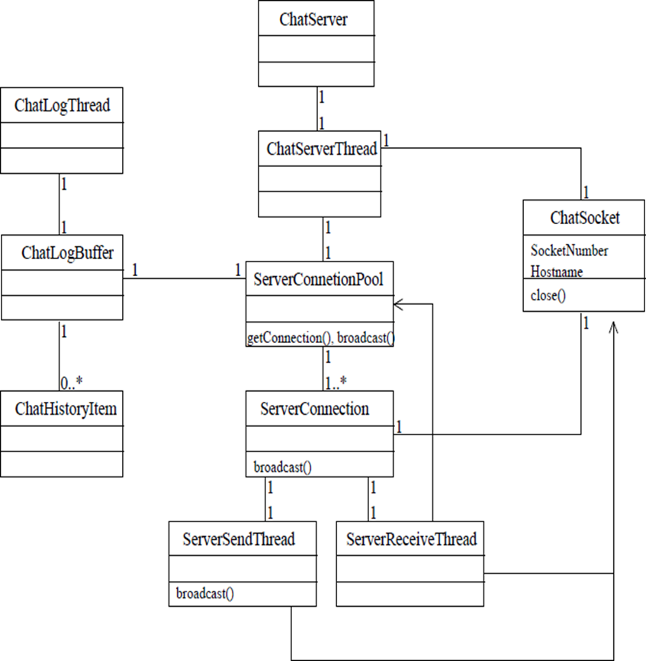
Class Diagram Of Server:

Slide 11
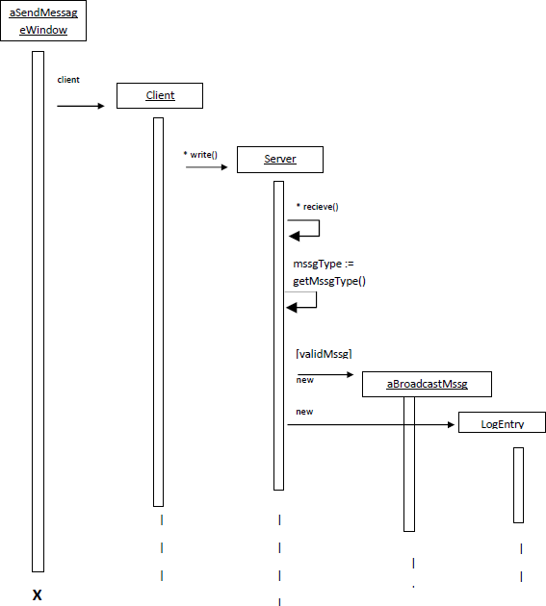
Sequence Diagram:

Slide 13
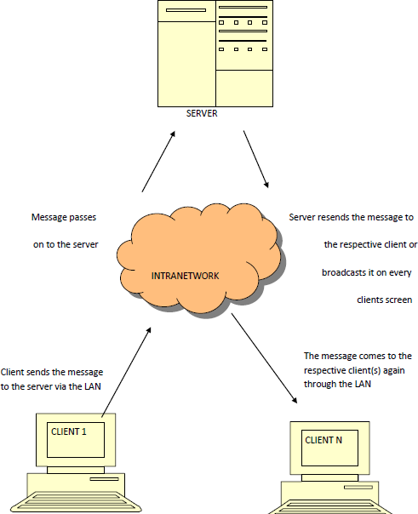
E-R Diagram:

Slide 14
Assessment Parameter
Gather requirements for the project
add Readme.md file with description of the project
Prepare database design schemas
Check-List
Commit all changes with "first commit"
Get your initial project Structure ready
create a repository on github realted to project
Initiate a git repository
Push your changes to github

Slide 15
Submission Github
https://github.com/VIJAYARAGHULG

